Slide 1

RFM ANALYSIS-CUSTOMER SEGMENTATION
FOR ONLINE GROCERY SHOP
Presented By-
Kamini Bobade
DA Batch-45
Coding Invaders

Slide 2
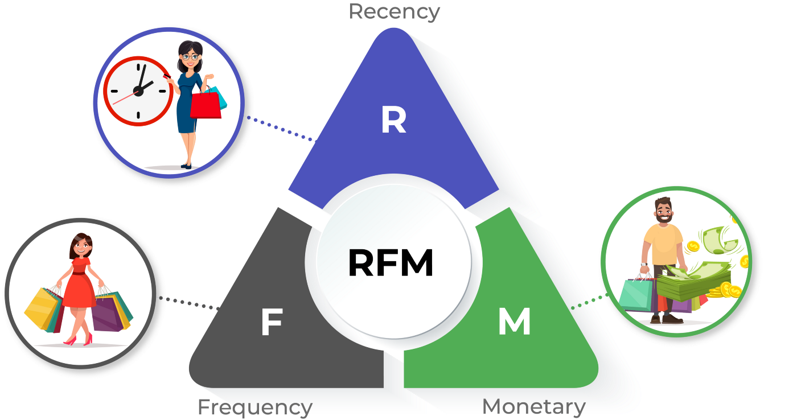

Slide 3
Assumptions
Customer who will more likely to buy again whose Recency is less.
Customer whose purchase quantity is more, those will respond more.
Customer whose purchase total is more they will respond more.
Customer whose Recency is more and purchase quantity is less those will going to churn.
Not considered negative values because those are not part of Revenue.(Outgoing from Business)

Slide 4
Country Based Segmentation
Segments | Australia | China | India | United Kingdom | USA
At Risk | 120 | 117 | 118 | 114 | 98
Champions | 55 | 41 | 53 | 59 | 58
Loyal Customers | 63 | 65 | 57 | 62 | 74
Need Attention | 90 | 86 | 90 | 81 | 92
Potential Loyalists | 138 | 131 | 131 | 135 | 141
Grand Total | 466 | 440 | 449 | 451 | 463

Slide 5
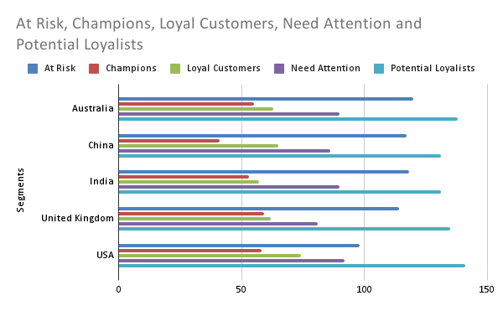
In the graph we can see mostly customer are from Potential Loyalists category which means maximum customers have retain by store which cant be churn to other competitors which is belonging from USA.

Slide 6
Customer Segmentation
Segments | Total Per Segment | AVERAGE of Recency Value | AVERAGE of Frequency Value | AVERAGE of Monetary Value
At Risk | 567 | 503 | 1.26 | 49.394
Champions | 266 | 233 | 7.10 | 254.960
Loyal Customers | 321 | 297 | 4.47 | 193.893
Need Attention | 439 | 354 | 1.32 | 47.673
Potential Loyalists | 676 | 256 | 1.38 | 39.493
Maximum revenue earning from Champions segments.

Slide 7
Interpretation
By managing different customers by different scoring by Recency, frequency and the monetary value or we can say revenue, we able to categorized in Seven Segments for targeting:
Champions Customers Segment(12%): So champions customers have purchased average 7 times in the evaluation period, and their average spending is high as compare to other segments that is $255 and purchased within the 233 days on average.
At Risk & Need Attention(44%): So champions customers have purchased average 7 times in the evaluation period, and their average spending is high as compare to other segments that is $255 and purchased within the 233 days on average.

Slide 8
Learnings / Findings
Who are your best customers?
-Most Recent, Most Frequent and High Spend customers or Champion
Which of your customers could contribute to your churn rate?
-Transacted frequently ,Spent a lot, but it’s been a long time since they’ve transacted that is At risk and need attention customers.
Who has the potential to become valuable customers?
-loyal customers and potentially loyal customers are the most valuable segments of the customers.
Which of your customers can be retained?
-Need attention segment of the customers
Which of your customers are most likely to respond to engagement campaigns?
-At-risk, need attention segments' customers.

Slide 9
Recommendation
Need to create target campaign to re-engage to At-risk and need attention customers with different offers and incentives.
Further need to analyse to Champion customers, Potential loyal, Loyal customers to maximize revenue or earnings.
Benefits
Maximize Revenue
Increased Response Rate
Increased Customer Retention

Slide 10


